Slide 1
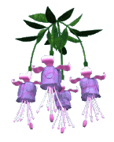
INFERTILITY
INFERTILITY
Dr Shanthi Serene Sylum V
Professor and Head
Dept. Obstetrics and Gynaecology
SKHMC Kulasekharam

Slide 2
Pregnancy is one of the fore most ambition of each and every women. This divine gift can be achieved through Homoeopathy with the help of experienced homoeopaths. A good homoeopathic physician can win a lot of Infertility cases with a good knowledge in Homoeopathic subject & medicine.

Slide 3
Definition
Infertility is defined as a failure to
conceive within one or more years of
regular unprotected coitus.

Slide 4
Classification
primary infertility secondary infertility

Slide 5
pathological infertility
(1) faulty male factors
(2) faulty female factors
(3) faulty combined male and female factors
physiological infertility
present before puberty
after menopause ,
during pregnancy
during lactation

Slide 6
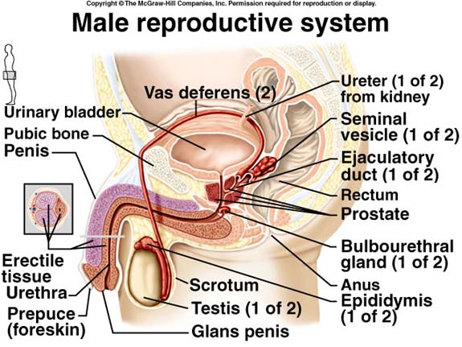
Factors essential for conception in males are:
SEMEN: A good quantity of semen with sufficient numbers of spermatozoa with good motility and normal morphology
PASSAGE : Patency of passage from the epididimis to the opening of the ejaculatory ducts
POTENCY: Ability of the husband to implant semen in the posterior fornix of the vagina

Slide 7
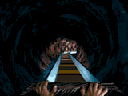
Common causes of male infertility
Defective spermatogenesis
Obstruction of efferent duct
Failure to deposit sperms high in the vagina
Defect in sperm and seminal fluid

Slide 8
Defective spermatogenesis
Congenital factors
undescented testis
Kartagener syndrome
Hypospadias
Thermal factors
Varecocele
Big Hydrocele
Filariasis
Working in blast furnaces
Wearing tight under garments
Endocrinal factors
Thyroid dysfunction,
Gonadotropin deficiency
Frohchlich’s syndrome
Hyper prolactinemia
Idiopathic testicular failure
Infections
Orchitis (mumps)
Vanerial diseases
Gonorrhoea,
Non gonococal urethritis
Tuberculosis
genetic factors
Klinefelter’s syndrome 47xxy
Immunological factors
Antibodies against spermatozoal surface antigen result in sperm clumping after ejaculation

Slide 9
Congenital factors
undescented testis
Kartagener syndrome
Hypospadias
testicular toxins (Drugs, radiation)
General factors
Malnutretion
Heavy smoking
Alcoholism
Chronic debilitating diseases

Slide 10
Thermal factors
Varecocele
Big Hydrocele
Filariasis
Working in blast furnaces
Wearing tight under garments

Slide 11
Endocrinal factors
Thyroid dysfunction,
Gonadotropin deficiency
Frohchlich’s syndrome
Hyper prolactinemia
Idiopathic testicular failure

Slide 12
Infections
Orchitis (mumps)
Vanerial diseases
Gonorrhoea,
Non gonococal urethritis
Tuberculosis

Slide 13
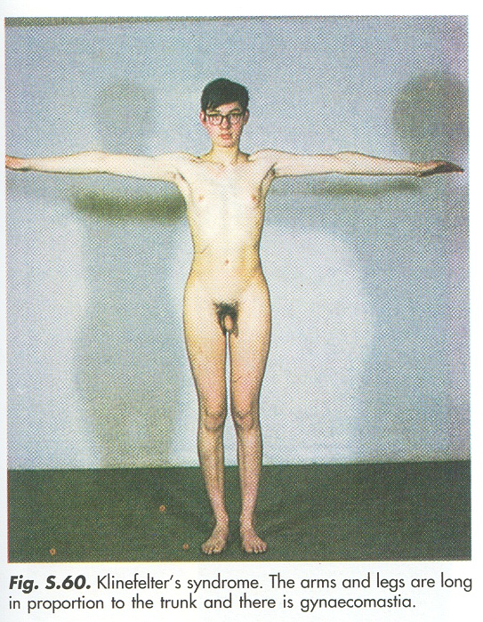
genetic factors
Klinefelter’s syndrome 47xxy

Slide 14
Immunological factors
Antibodies against spermatozoal surface antigen result in sperm clumping after ejaculation
testicular toxins (Cytotoxic Drugs, Nitrofurantoin, Antihypertensive, cimetidine, Anticonvulsant & antideprescent, radiation)
General factors
Malnutretion
Heavy smoking
Alcoholism
Chronic debilitating diseases

Slide 15
Obstruction of Efferent duct
Congenital
Absence of vasdeferens (Cystic fibrosis)
Young’s syndrome
Acquired
Infective
Tuberculosis,
Gonorrhoea
Surgical trauma
Herniorrhaphy
Hydrocele operation
Bilateral Vasectomy

Slide 16
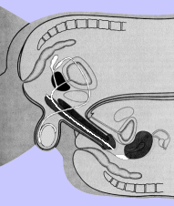
Failure to deposite sperms high in the vagina
Impotency Temporary Permanent
Ejaculatory failure
Premature ejaculation
Retrograde ejaculation
Absence of ejaculation
Hypospadias
Penile type
Scrotal type
Bladder neck surgery

Slide 17
Defect in sperm and seminal fluid
Immotile sperm (Kartagener syndrome)
Oligospermia, Asthenozoospermia
Necrozoospermia,
Abnormal sperm morphology
Teratozoospermia
Low fructose content
Unusually high or low volume of ejaculate
Undue viscosity
Sperm antibodies
High prostaglandin content

Slide 18
General management in the case of MALES:-
1.Improvement of general health
2.Advise to avoid tight undergarments
3.Advise cold baths
4.Correction of Varicocele
5.Hormonal theraphy
6.Hypospadias and phimosis should be surgically corrected.
7.Impotency,premature ejaculation and similar problems must be treated.

Slide 19
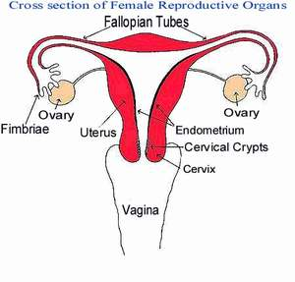
Factors essential for conception (fertilization of ovum) in female are
OVA: production of ovum
PASSAGES: Patency of passages from the vagina to the fimbrial end of the fallopian tube
HOSPITALITY: The condition of genital tract should be hospitable for the spermatozoa and implantation of the fertilized ovum.

Slide 20
Common causes of Female infertility
OVARIAN FACTORS:
Anovulatory or oligo-ovulation
Luteal phase defect(LPD)
Lutenisied unruptured follicle(LUF)
TUBAL FACTORS
PERITONEAL FACTORS
UTERINE FACTORS
CERVICAL FACTORS
VAGINAL FACTORS

Slide 23
OVARIAN FACTORS:
The ovulatory dysfunctions encompass:
Anovulatory or Oligo-ovulation
Luteal phase defect (LPD)
Luteinized Unruptured Follicle (LUF)

Slide 24
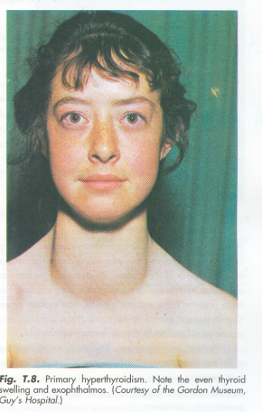
Anovulation or oligo-ovulation
The ovarian activity is totally dependent on the gonadotropins.
Normal secretion of gonadotropins depends upon the pulsatile release of GnRH from the hypothalamus.
As such the ovarian dysfunction is likely to be linked with the disturbed hypothalamo-pitutary-ovarian axis either primary or secondary from thyroid or adrenal dysfunction.

Slide 25
Luteal phase defect (LPD)
Inadequate growth and function of the corpous luteum.
Inadequate progesterone secretion.
The life span of corpus luteum is shortened to less than 10 days.
It is also due to defective folliculogenesis.

Slide 26
Lutenised unruptured follicular syndrome (Trapped ovum)
In this condition the ovum is trapped inside the follicle which gets lutenisied.
It may be associated with Pelvic Endometriosis or Hyperprolactinaemia.

Slide 27
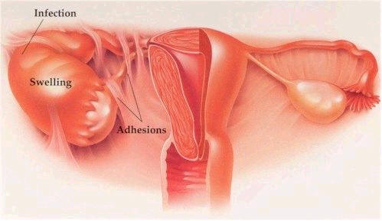
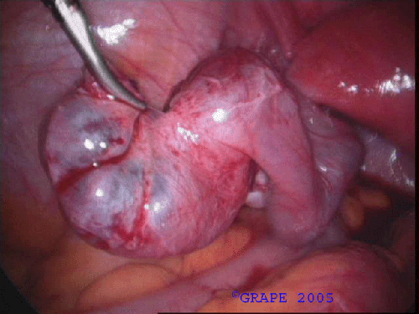
TUBAL FACTORS:-
Impaired tubal function include defective ovum picking (octopus function)
Impaired tubal motility
Loss of cilia and partial or complete obstruction of tubal lumen.
This is related to
Tubal infection,
Peritubal adhesion following pelvic surgery, Infection -TB, Endometriosis.

Slide 28
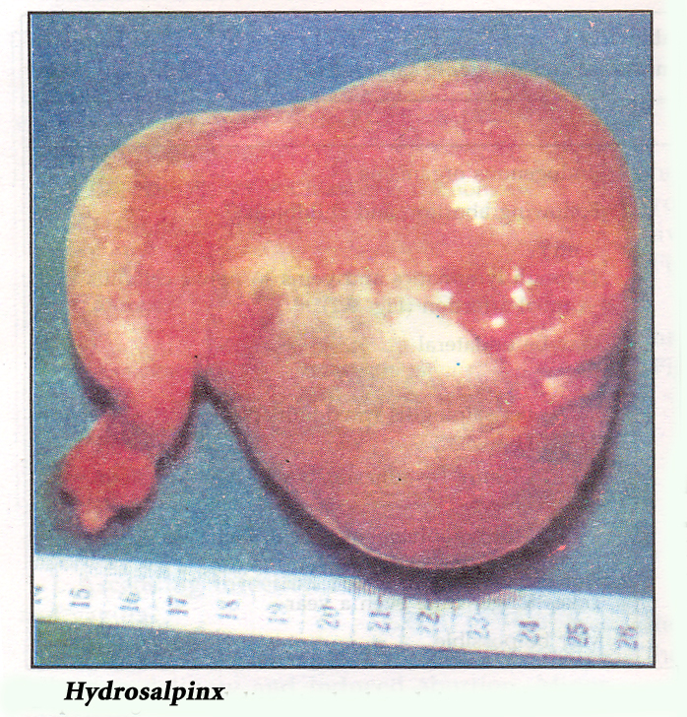

Slide 29
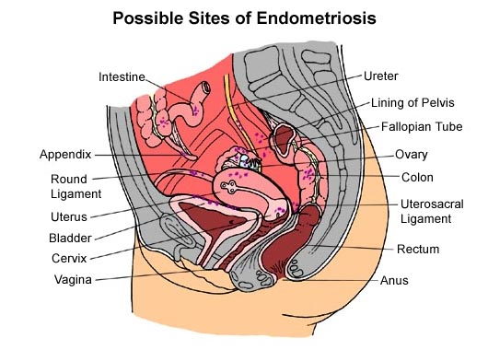
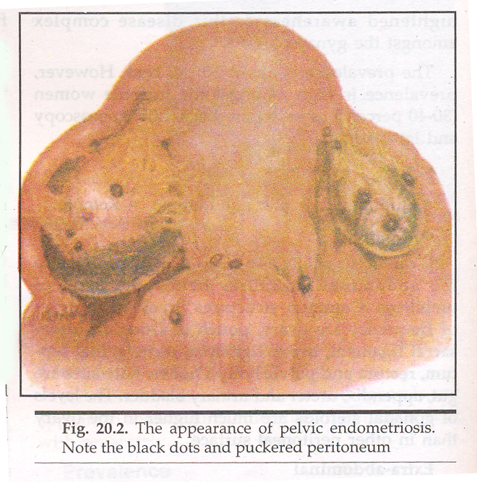
PERITONEAL FACTORS:
Here minimal endometriosis may produce infertility. Deep dyspareunia may trouble the patient.

Slide 30
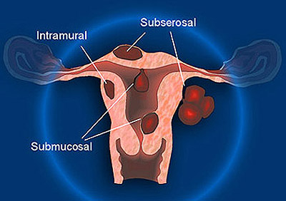
UTERINE FACTORS:
The factors that hinder nidation are:-
uterine hypoplasia,
congenital malformation of uterus,
inadequate secretary endometrium,
fibroid uterus,
endometritis,
uterine synechaie

Slide 31
Female genital tract developed from 3 origins:
1. Ovaries from the germ cells that migrate from the yolk sac into the mesenchyme of the peritoneal cavity and developed into ova and supporting cells.
2. Lower third of vagina developed from the ascending Sino vaginal bulb.
3. Uterus, fallopian tubes &upper two thirds of vagina developed from the fusion of two Mullerian ducts

Slide 32
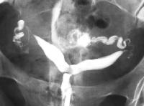
Formation of the genital tract
Uterus, fallopian tubes &upper two thirds of vagina developed from the fusion of two Mullerian ducts
If one of the tubes fail to develop it results in unicornuate uterus. If both this cause uterine agenesis or hypoplasia. The two Mullerian ducts by Lateral fusion process, fuse together to form the uterus, tubes &cervix. Failure of this process cause bicornuate or didelphys uterus.
Normally the median part of the fused Mullerian ducts forms septum that resorbed to form single uterine cavity. Failure of this resorption lead to septate uterus complete or partial.

Slide 33
CERVICAL FACTORS
Anatomic defects
congenital elongation of cervix, second degree uterine prolapse acute retroverted uterus
Pin whole OS
Cervical polyp occluding external OS
Due to fault in the composition of the cervical mucus
Conisation - biopsy
deep cauterization of cervix
amputation of cervix.

Slide 34
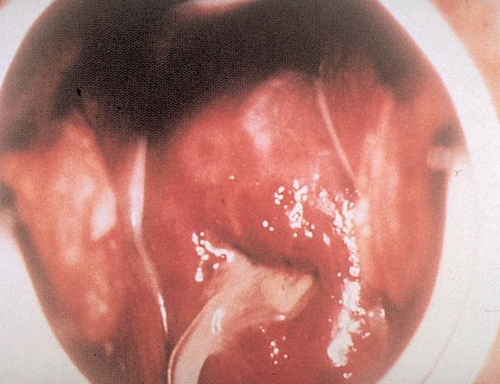
CERVICAL FACTORS….
chronic cervicitis.
immunological factor -
Presence of antisperm or sperm immobilizing antibodies in cervical mucous.
Physiologic- The fault lies in the composition of the cervical mucus,that spermatozoa fail to penetrate the mucus.

Slide 35
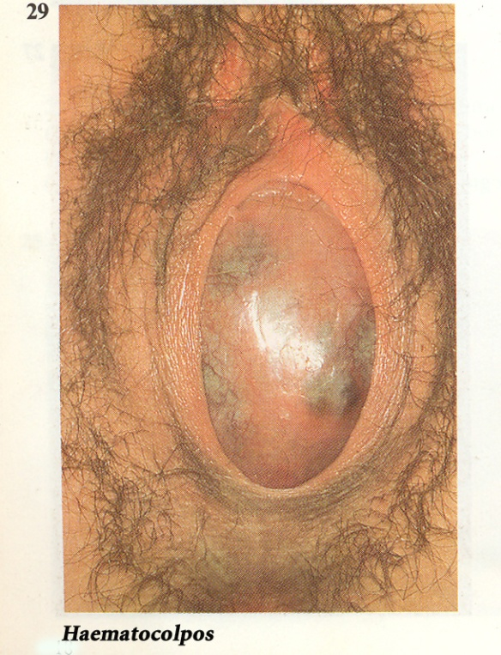
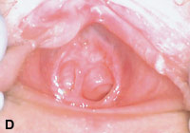
VAGINAL FACTORS:-
Atresia vagina,
Transverse vaginal septum,
Septate vagina and
Narrow introitus
This causes dyspareunia.
They are included under the congenital group.
Vaginitis and purulent vaginal discharge
Imperforated hymen
Septate hymen

Slide 36
Common combined factors:-
General factors:- Advanced age of wife beyond 35yrs is related.
Infrequent intercourse,
lack of knowledge of
coital technique and
timing of coitus to utilize
The fertile period
Apareunia and Dyspareunia.
Anxiety and apprehension.
Use of spermicidal lubricants during intercourse.
Immunological factors.

Slide 37
INVESTIGATIONS
A couple living together and not using contraceptive methods failed to conceive after 2 yrs should be investigated. Both the partners should be investigated. Investigation of the male is more easier and so this should be done first.

Slide 38
FEMALE INVESTIGATIONS-
HISTORY
Age- 20 – 25 yrs (peak of fertile period)
Duration of marriage
H/o previous marriage with proven fertility if any.
Marital relationship
Coital problems- Dyspareunia, loss of libido.
Use of contraceptions (IUCD may produce PID)
Detailed analysis of psycho sexual problems. general medical history with reference to TB, STD, PID, DM, Mumps, Peritonitis.
SURGICAL HISTORY:-
Abdominal surgery
Pelvic surgery
Both related to peritubal adhesions.

Slide 39
FEMALE INVESTIGATIONS……
MENSTURAL HISTORY
Hypomenorrhoea,Oligomenorrhoea,Amenorrhoea are associated with disturbed hypothalamo pituitary ovarian dysfunction, this may accompany adrenal or thyroid dysfunction.
PREVIOUS OBSTETRICAL HISTORY:
Number of pregnancy, Interval b/w each pregnancy. h/o pregnancy related complications in case of secondary infertility.
History of premature rupture of membrane and puerperal sepsis may produce ascending infection leads to tubal damage.

Slide 40
FOR DIAGNOSIS OF OVULATION VARIOUS METHODS ARE USED:-
Indirect methods-
a.Menstural H/o
b.Evaluation of peripheral or end organ changes
-BBT
-Cervical mucus study
-vaginal cytology
-Hormone estimation
-Serum progesterone
-Serum LH
-Serum oestradiol
-Endometrial biopsy
c. Ultra sonography
Direct method
-Laproscopy
Conclusive method
-Pregnancy

Slide 41
FOR DIAGNOSIS...…
Tubal factors:-
1.Dilatation and insufflations test.
2.Hystero salpingography.
3.Laproscopy and chromopertubation.
4.Sonohystero salpingiography.
5.Falloposcopy.
6.Salpingoscopy.

Slide 42
FOR DIAGNOSIS……
Cervical factors:-
Post coital test (PCT)
Sperm cervical mucus contact test
Endocrinopathy:
Estimation of serum TSH, Prolactin, FSH, LH, Dehydroepiandrosterone sulphate, testosterone and progesterone in mid luteal phase.

Slide 43
Thank you

Slide 44
In the State Campaign we are discussing about the strength of Homoeopathy in mother and Child health Care. From time immemorial, Fertility is the basis of life. Delivering a child and growing it up in a family is a real joy of life.
But becoming Mother itself is a problem. There is no motherhood with out conception.
So I would like to present a paper on
INFERTILITY

